Slide 1

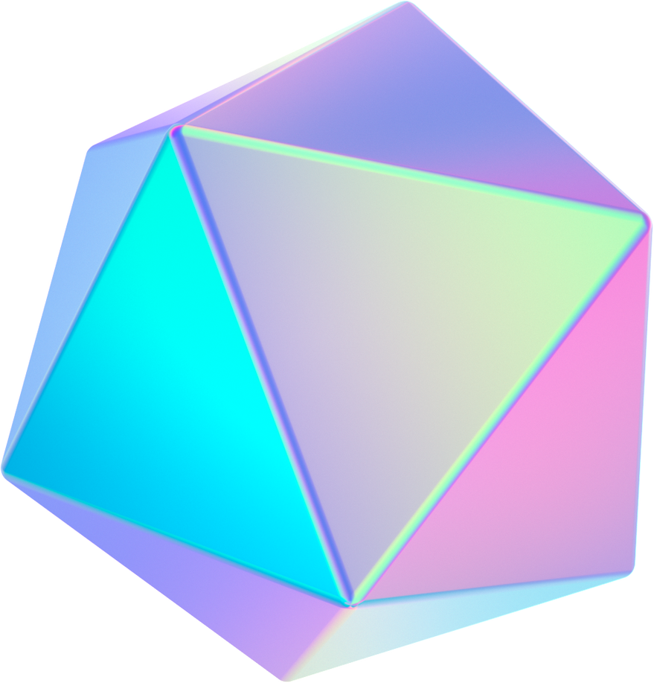




Dev Rockers
Unlocking Holistic Wellness:
Bridging Ayurveda and Technology for a Healthier Tomorrow

Slide 2
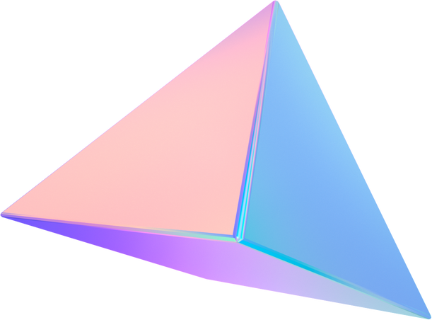
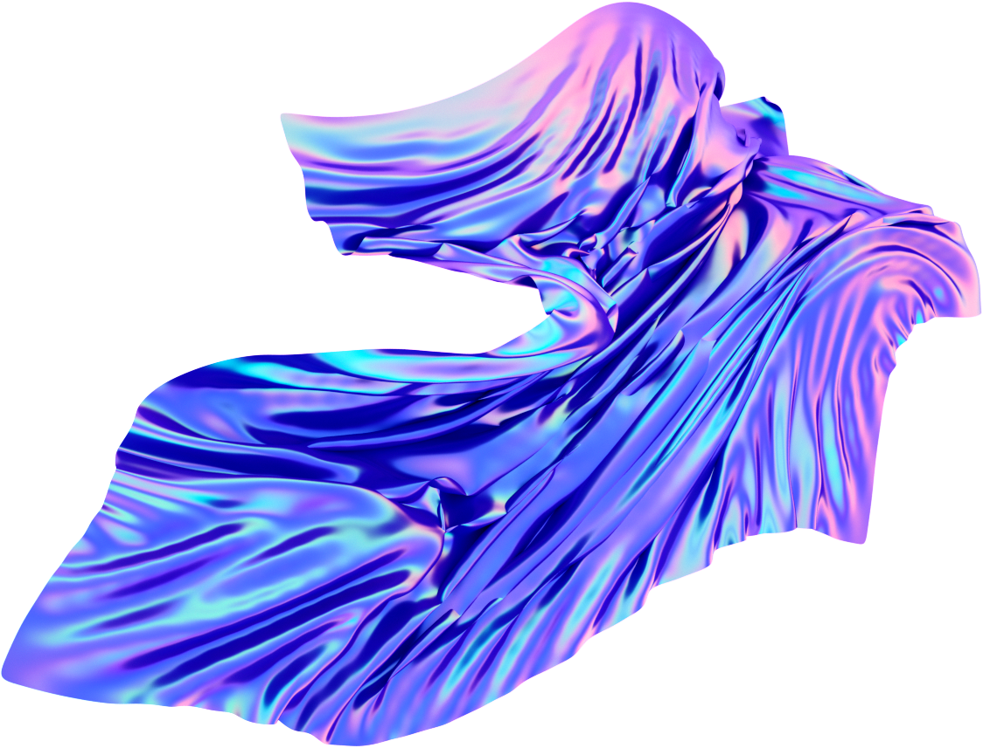
Problem Statement
Modern healthcare neglects the profound holistic insights of Ayurveda, leading to delayed interventions and incomplete disease predictions, demanding an integrated approach that harmonizes ancient wisdom with contemporary technology for a healthier future.

Slide 3
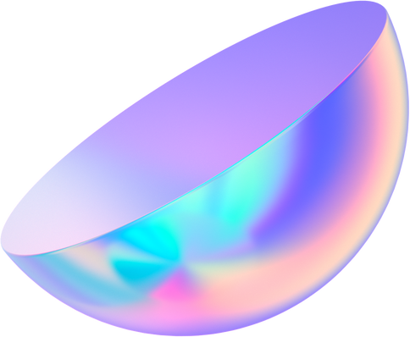
Problems
Ayurvedic insights untapped: Ayurveda offers valuable holistic wisdom that can complement modern medicine.
Lack of holistic disease prediction tools: Existing models often focus on symptoms without considering holistic approaches.
Delayed interventions: Late disease detection due to limited symptom-based predictions.

Slide 4
Solution
Ayurvedic education: Educate users about the Ayurvedic remedies they may already have at home but are unaware of their uses for specific diseases, promoting self-care and holistic well-being.
Combining AI and Ayurveda: Develop an integrated model that harnesses AI/ML for symptom-based predictions and Ayurvedic knowledge for holistic solutions.
User-friendly platform: Create a web application using Python and Django, offering a user-friendly interface.
Personalized herbal recommendations: Provide personalized herbal remedies based on predicted diseases, enhancing user engagement and well-being.

Slide 5



Tech Stacks
HTML
CSS
JAVASCRIPT

Slide 6
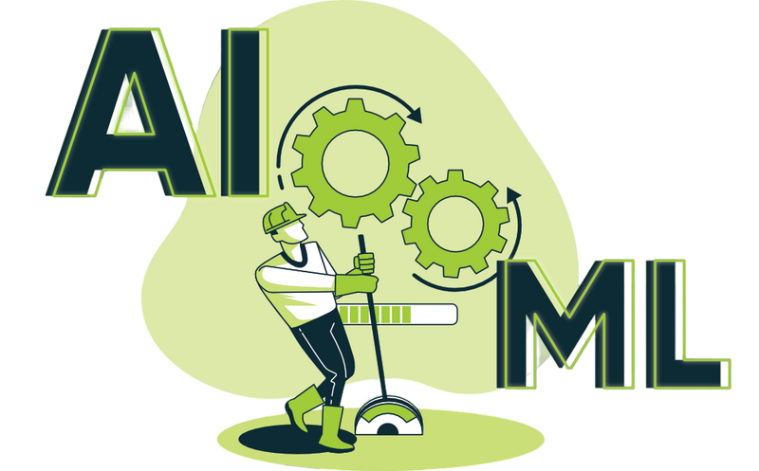
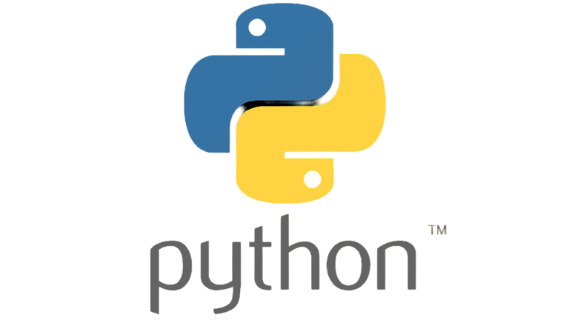


Tech Stacks
Python
Django
AI/ML

Slide 7
TechStacks
Python: Use Python for implementing machine learning and deep learning algorithms.
Django: Employ Django for building the backend and creating a robust web interface.
HTML/CSS: Utilize HTML, CSS and JAVASCRIPT for designing the user-friendly frontend.
AI and ML: Implement AI and ML techniques for accurate symptom-based disease prediction.
Ayurvedic Knowledge: Integrate Ayurvedic knowledge databases to enhance holistic recommendations.

Slide 8
Uniqueness
Bridging ancient wisdom with modern technology: Our project uniquely integrates traditional Ayurvedic knowledge with cutting-edge AI/ML, providing holistic healthcare solutions.
Personalized recommendations: We stand out by offering personalized herbal remedies based on individual symptoms, addressing the specific needs of each user.
Holistic healthcare approach: Our model promotes holistic well-being by considering physical, mental, and emotional aspects, setting us apart from conventional symptom-based prediction models

Slide 9
Architecture of Idea
Frontend: Showcase the HTML/CSS interface for users to input symptoms and receive recommendations.
Backend: Explain how Django handles server-side logic and API requests for disease prediction and Ayurvedic suggestions.
Machine Learning: Outline the use of Python and libraries like scikit-learn for symptom-based disease prediction.
Deep Learning: Highlight the incorporation of neural networks to enhance prediction accuracy.
AI Integration: Emphasize how AI connects ML predictions with Ayurvedic databases to provide comprehensive recommendations
-

